Slide 1
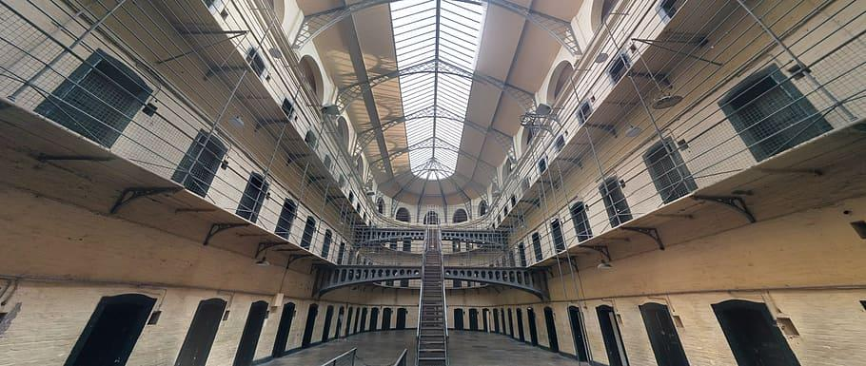
ESCAPE THE JAIL
CLICK
START

Slide 2

You clicked somewhere wrong..
Click on highlighted items:
BACK

Slide 3
You clicked somewhere wrong..
Click on highlighted items:
BACK

Slide 4
Click on green items to escape.
Press spacebar to continue if there is no items highlighted green.

Slide 5



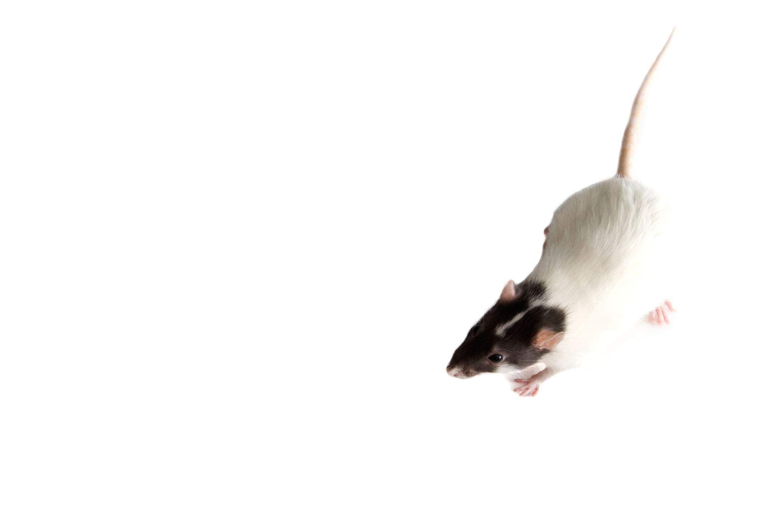


Slide 6
You clicked somewhere wrong..
Click on highlighted items:
BACK

Slide 7
You clicked somewhere wrong..
Click on highlighted items:
BACK

Slide 8

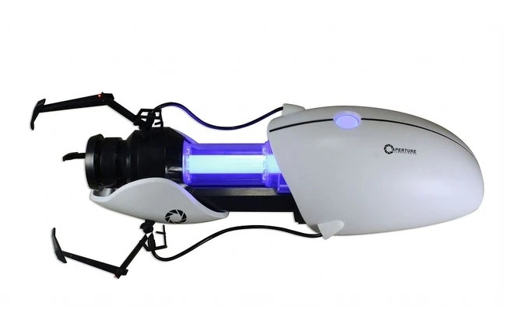



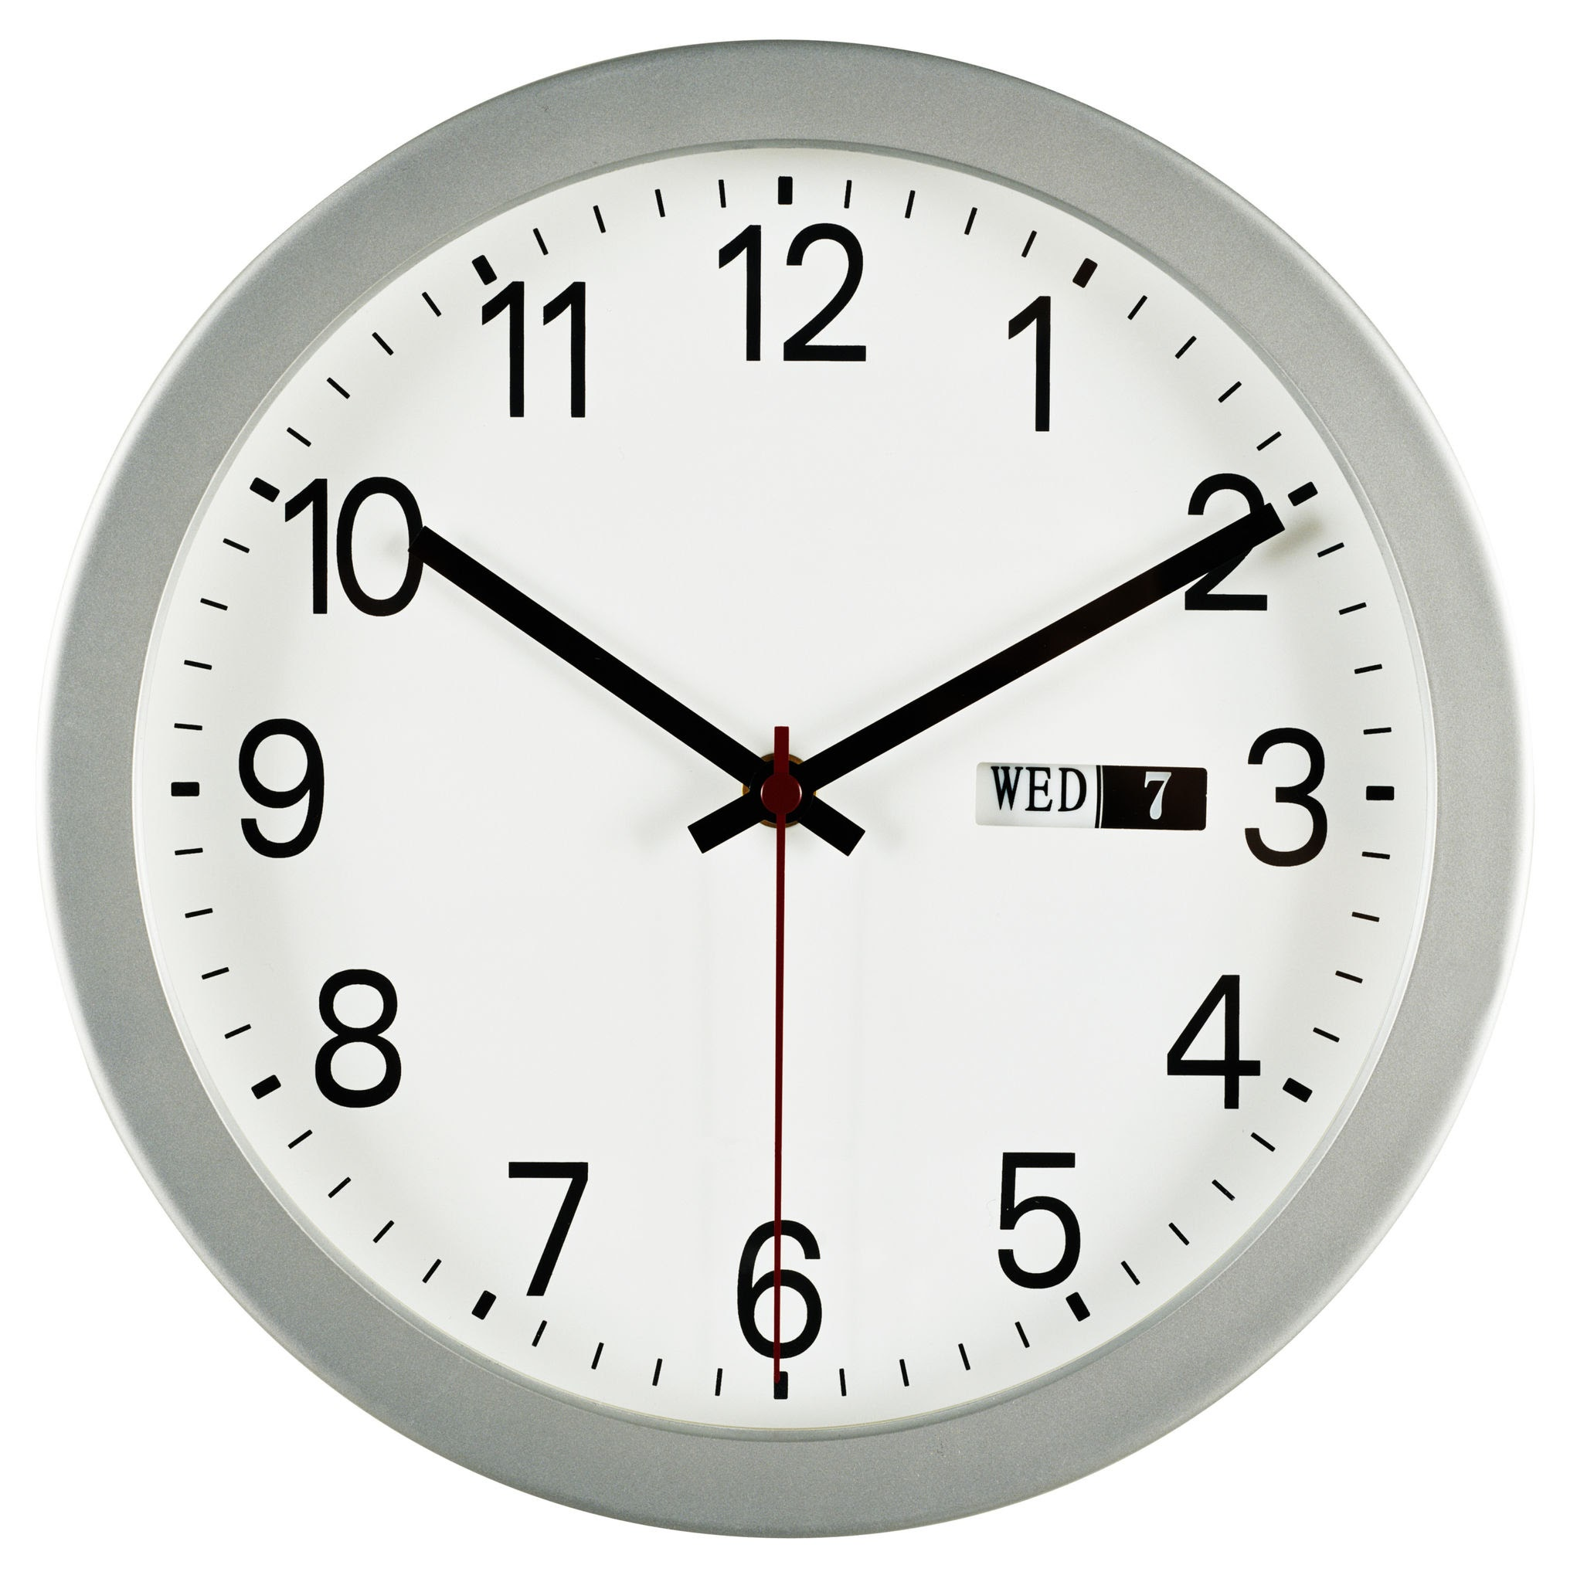




Slide 9
You clicked somewhere wrong..
Click on highlighted items:
BACK

Slide 10
You clicked somewhere wrong..
Click on highlighted items:
BACK

Slide 11

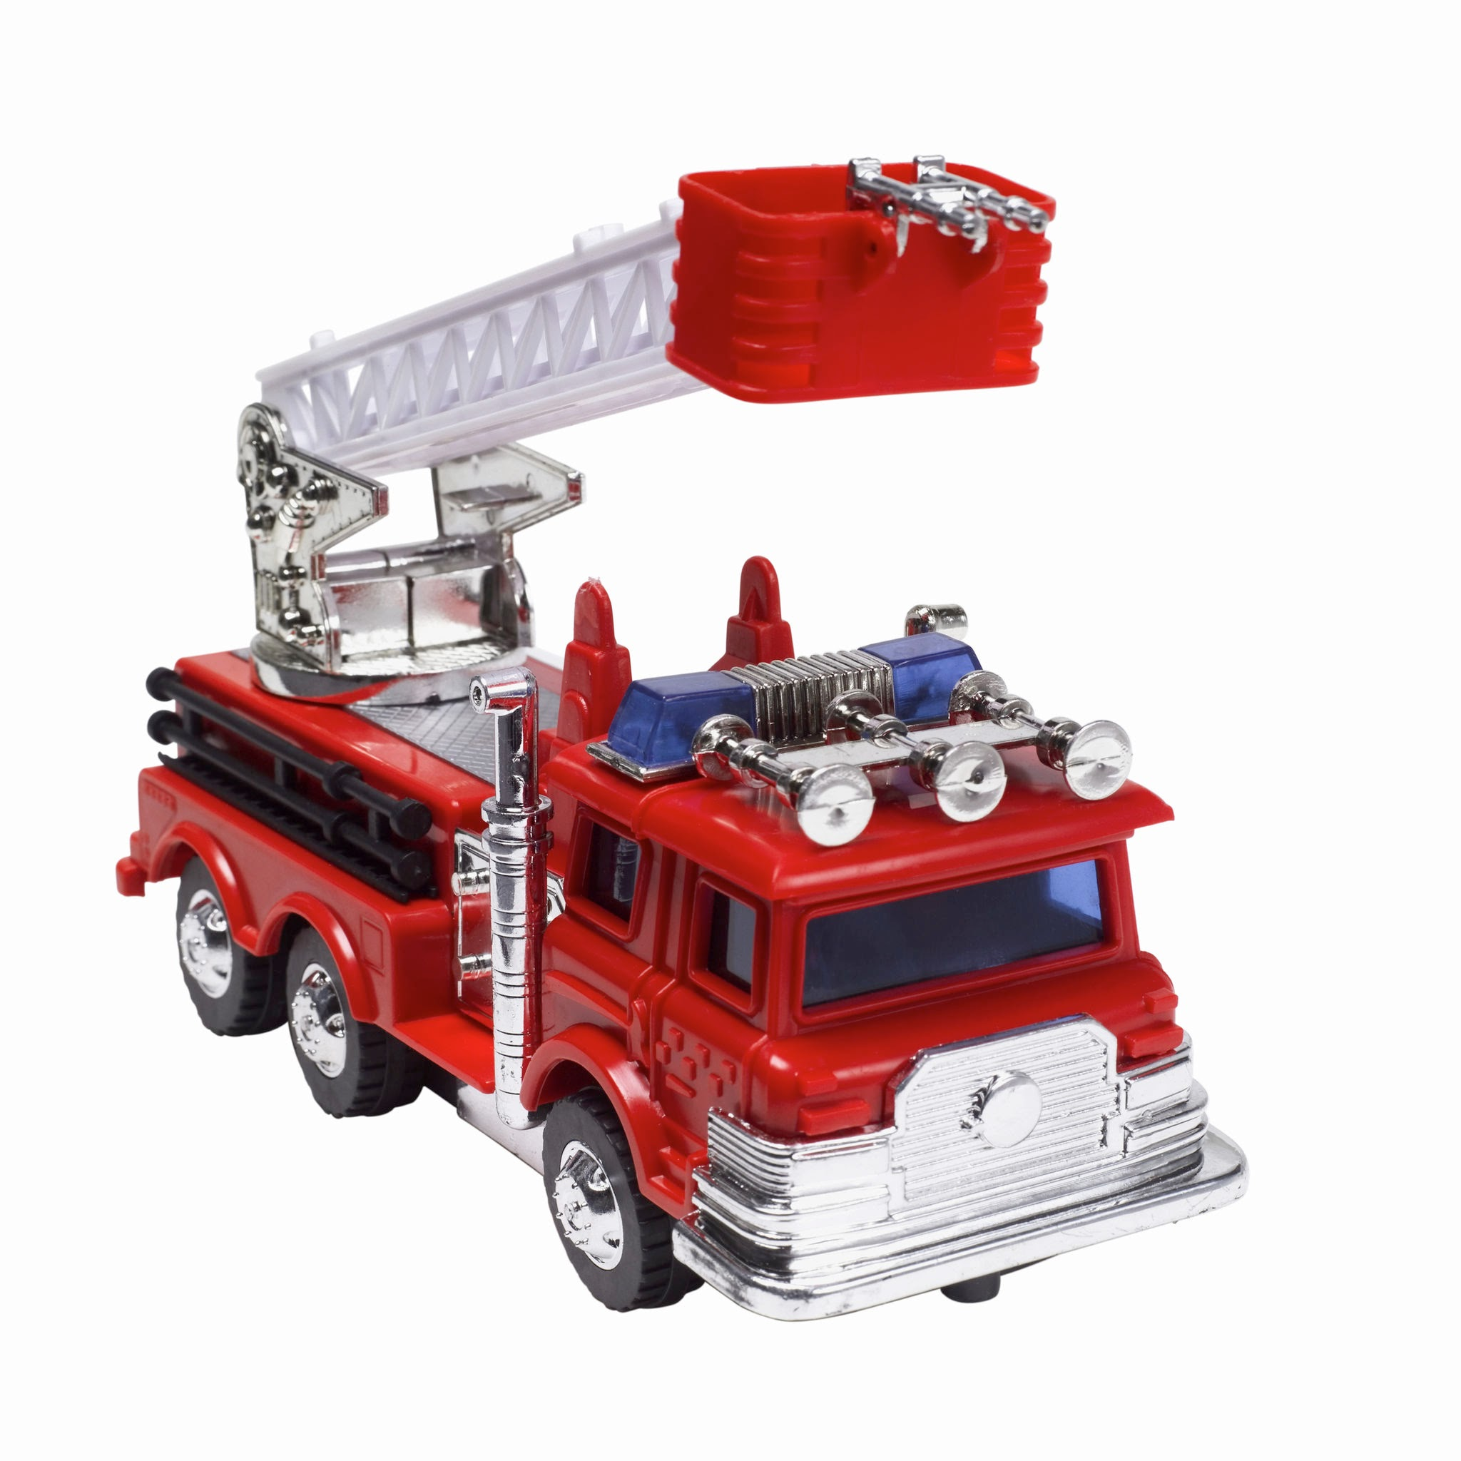

Slide 12
You clicked somewhere wrong..
Click on highlighted items:
BACK

Slide 13
You clicked somewhere wrong..
Click on highlighted items:
BACK

Slide 14
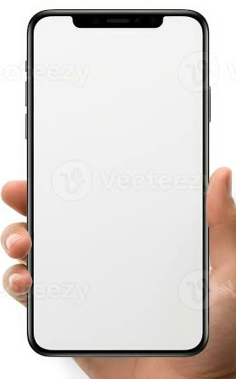
Evil Friend

Slide 15
Evil Friend
yo break me out
SEND

Slide 16
Evil Friend
yo break me out
ok
SEND

Slide 17

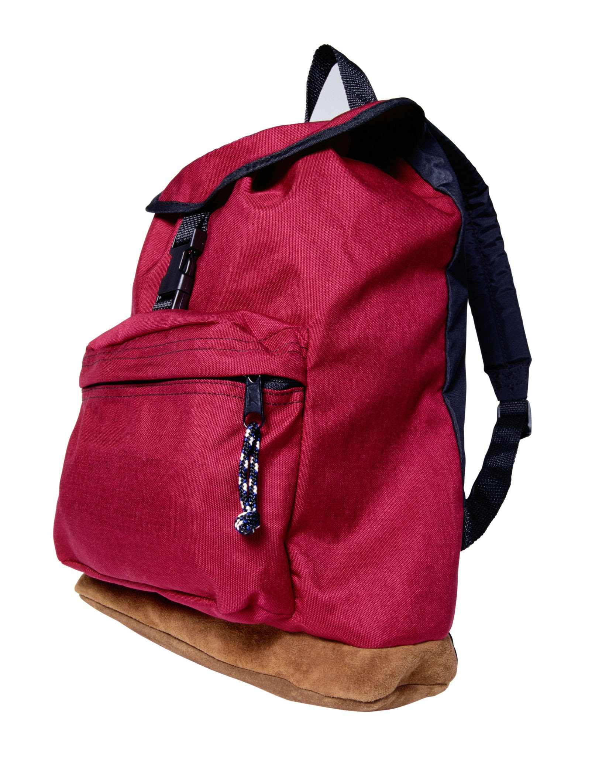
The Jail
ENTRANCE

Slide 18
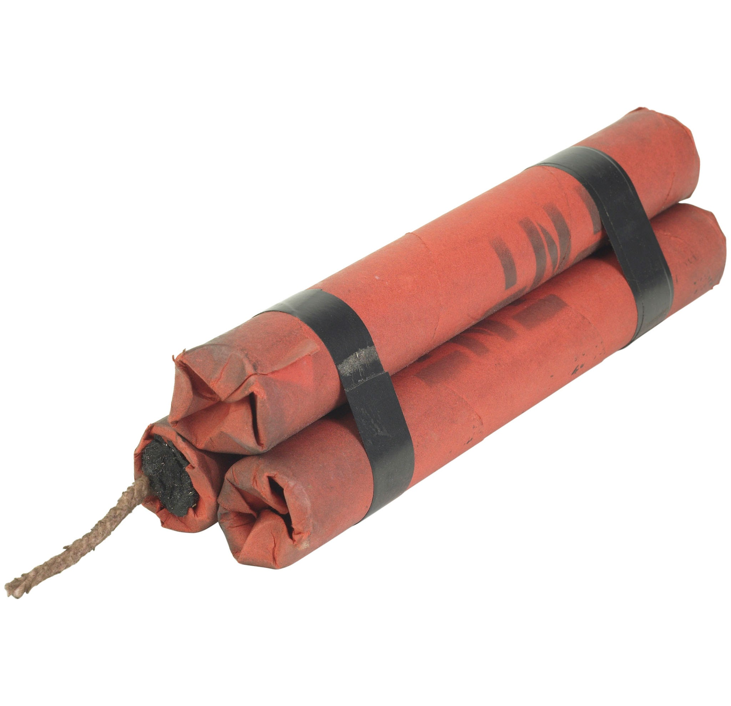
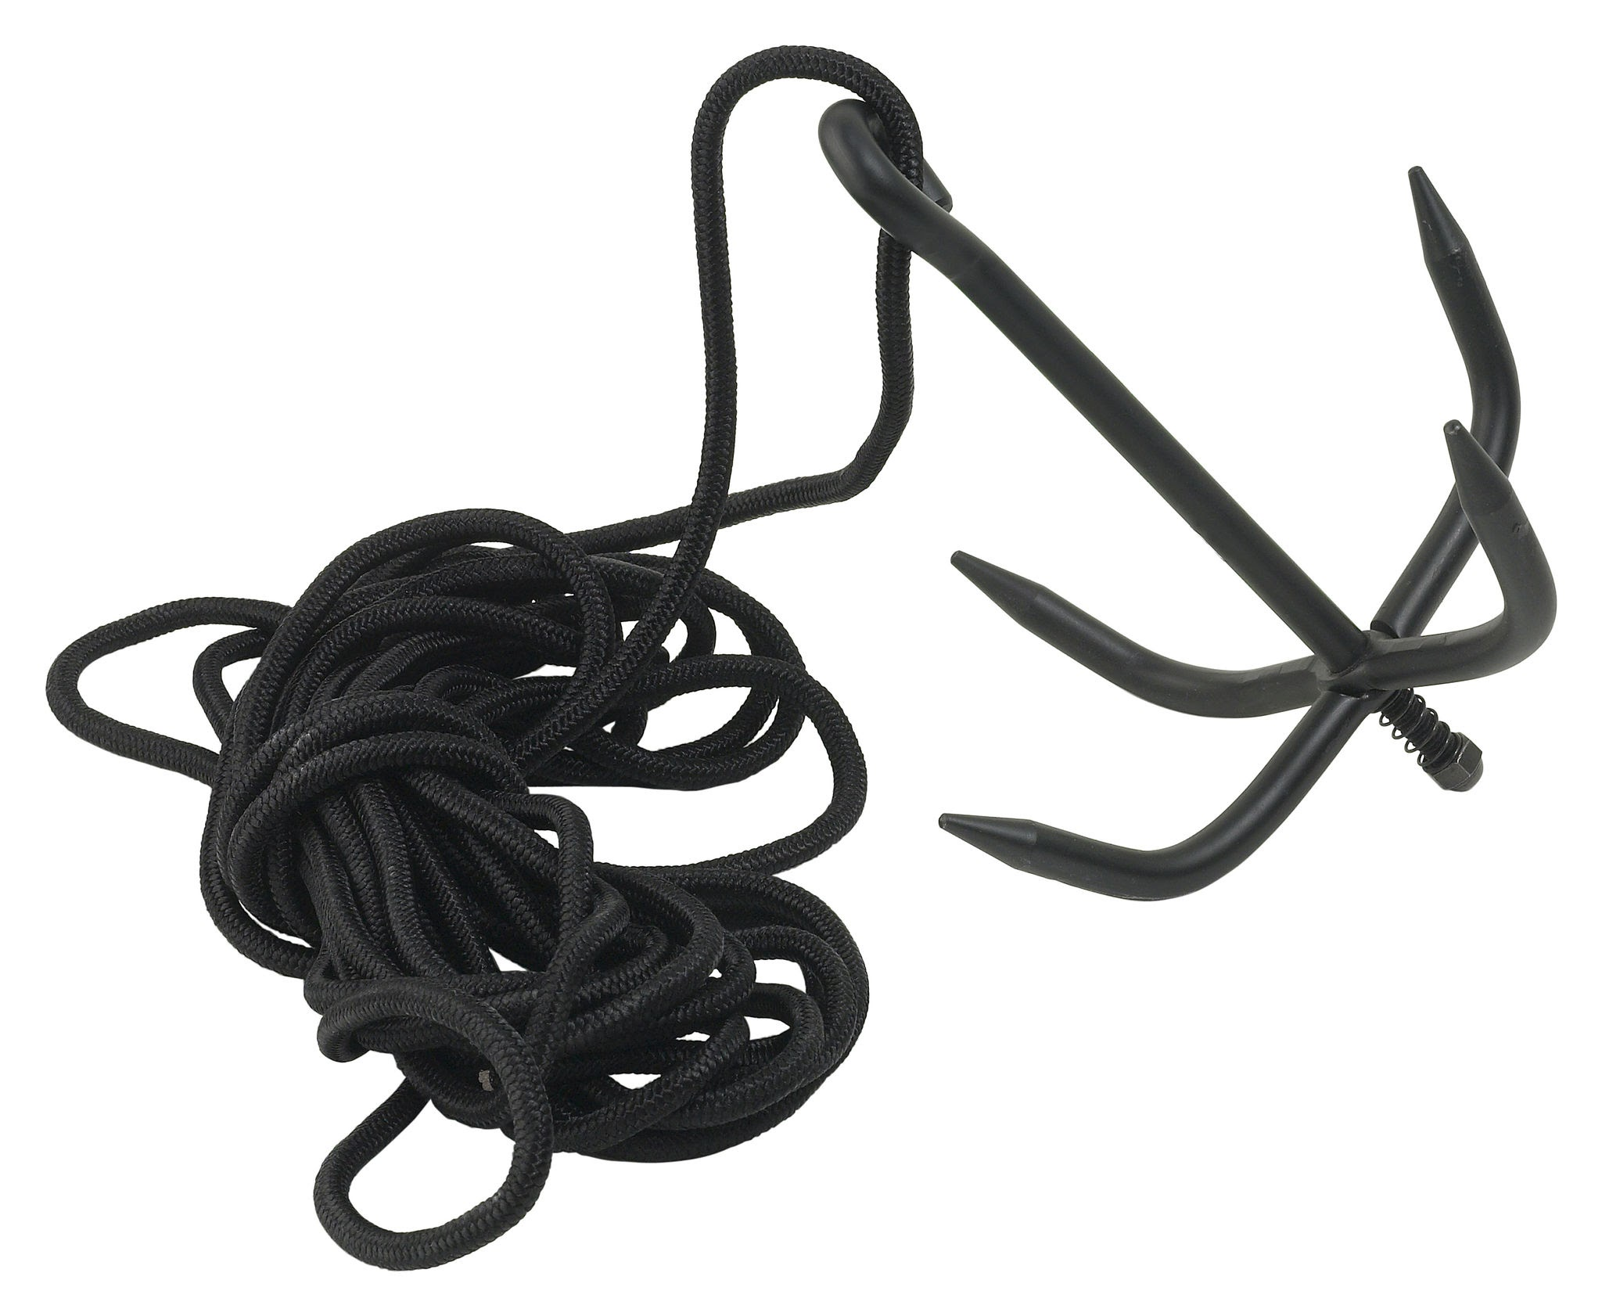
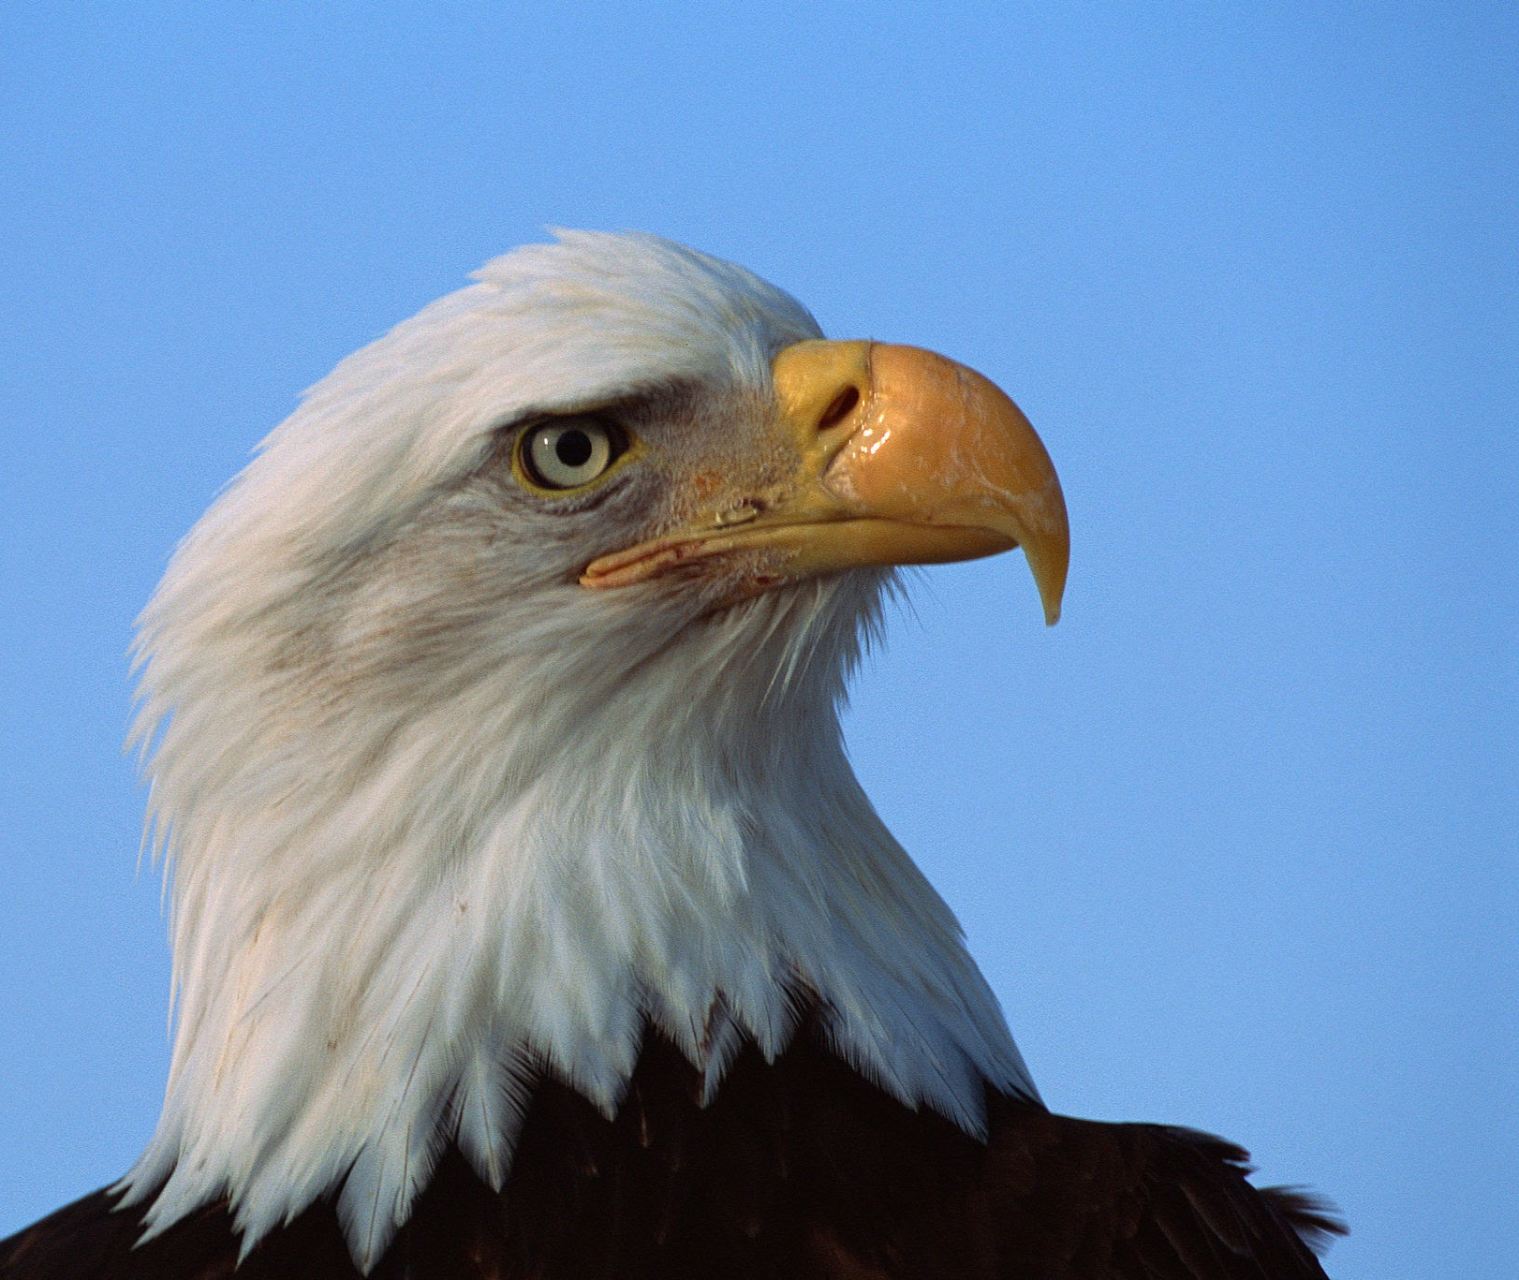


The Jail
ENTRANCE

Slide 19
You clicked somewhere wrong..
Click on highlighted items:
BACK

Slide 20
You clicked somewhere wrong..
Click on highlighted items:
BACK

Slide 21
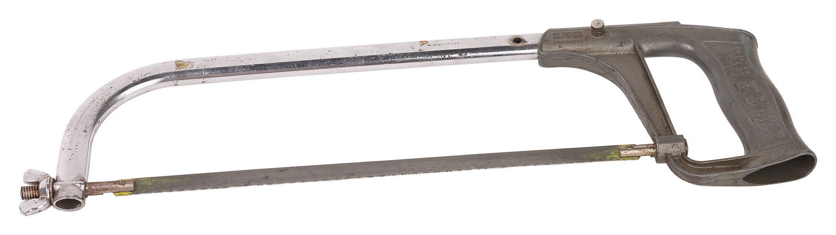
The Jail
ENTRANCE

Slide 22
You clicked somewhere wrong..
Click on highlighted items:
BACK

Slide 23
You clicked somewhere wrong..
Click on highlighted items:
BACK

Slide 24

ENTRANCE

Slide 25


ENTRANCE

Slide 26
YOU DIED
ENTRANCE
Your friend’s tnt caught the jail on fire..
RETRY

Slide 27
You clicked somewhere wrong..
Click on highlighted items:
BACK

Slide 28
You clicked somewhere wrong..
Click on highlighted items:
BACK

Slide 29
ENTRANCE

Slide 30

ENTRANCE

Slide 31
YOU DIED
ENTRANCE
Your friend couldn’t save you..
RETRY

Slide 32
You clicked somewhere wrong..
Click on highlighted items:
BACK

Slide 33
You clicked somewhere wrong..
Click on highlighted items:
BACK

Slide 34
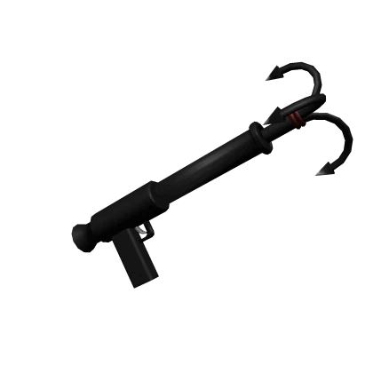
ENTRANCE

Slide 35
ENTRANCE

Slide 36
ENTRANCE

Slide 37
ENTER
ENTRANCE

Slide 38
You clicked somewhere wrong..
Click on highlighted items:
BACK

Slide 39
You clicked somewhere wrong..
Click on highlighted items:
BACK

Slide 40
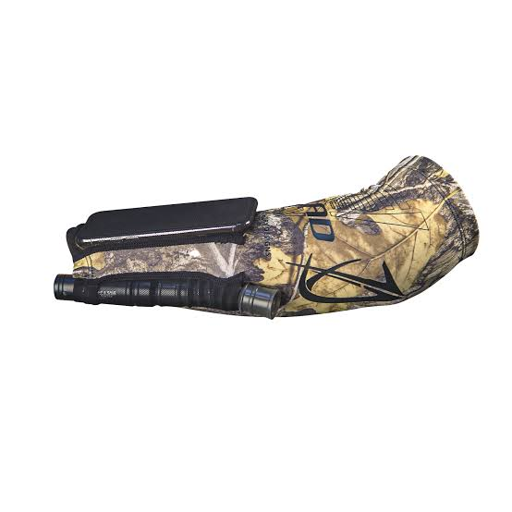
ENTRANCE

Slide 41

ENTRANCE

Slide 42
ENTRANCE

Slide 43
ENTRANCE

Slide 44
ENTER
ENTRANCE

Slide 45
You clicked somewhere wrong..
Click on highlighted items:
BACK

Slide 46
You clicked somewhere wrong..
Click on highlighted items:
BACK

Slide 47
ENTRANCE

Slide 48
ENTRANCE

Slide 49



Slide 51
YOU DIED
Your friend was caught..
RETRY

Slide 52
You clicked somewhere wrong..
Click on highlighted items:
BACK

Slide 53
You clicked somewhere wrong..
Click on highlighted items:
BACK

Slide 54
Firefighters
help im stuck
SEND

Slide 55
Firefighters
help im stuck
OK
SEND

Slide 56
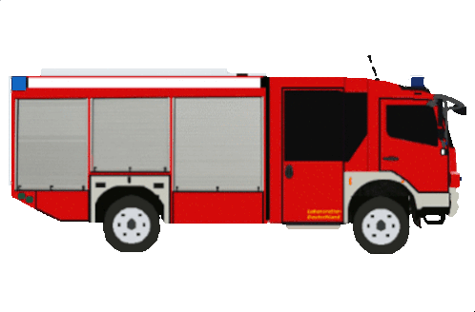
ENTRANCE

Slide 57
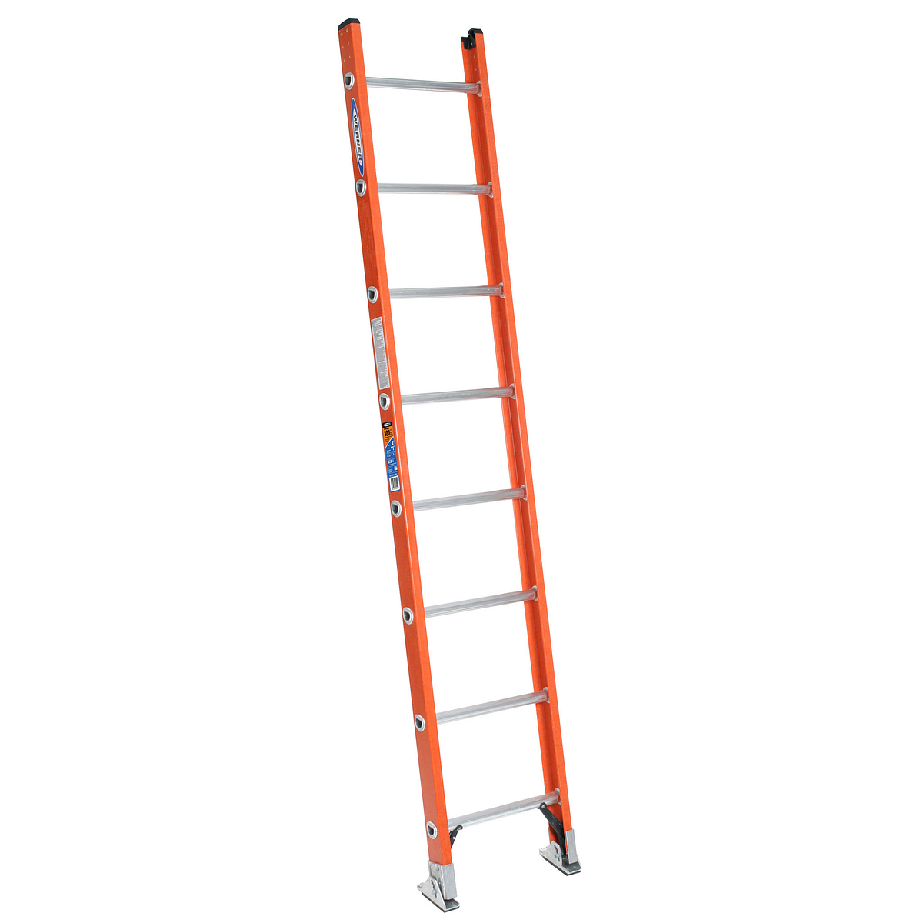
ENTRANCE

Slide 58
ENTRANCE

Slide 59
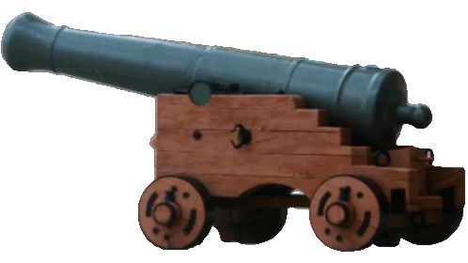
ENTRANCE

Slide 60
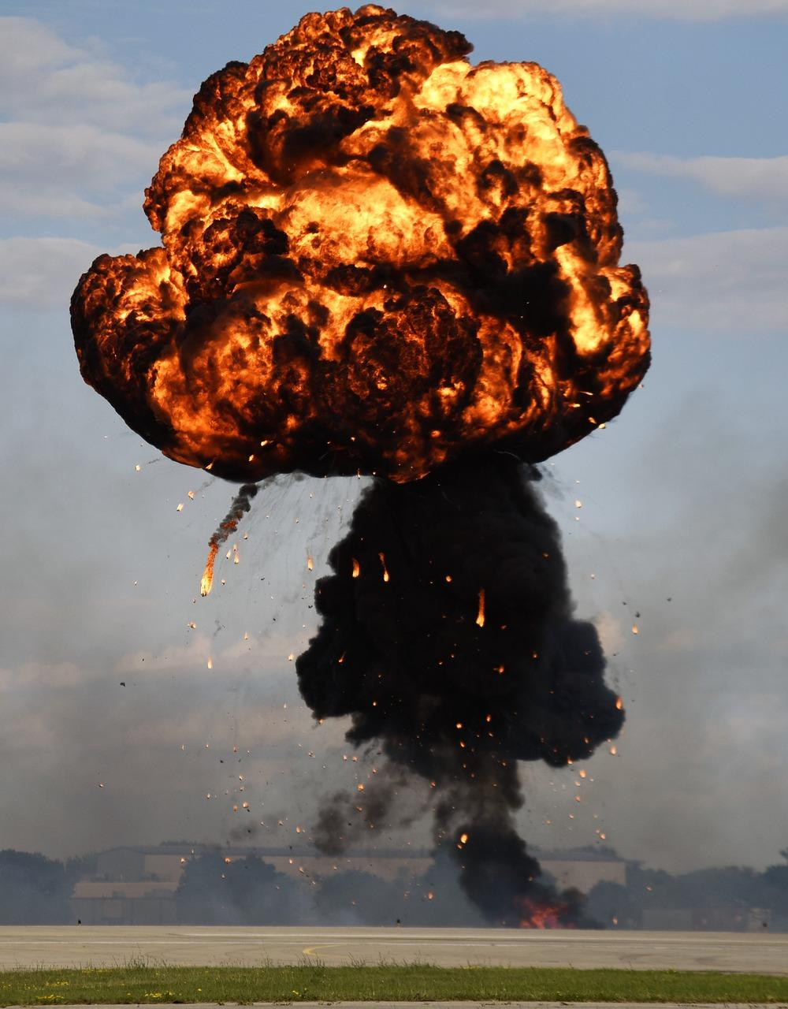
YOU DIED
ENTRANCE
The firefighters were caught.
RETRY

Slide 61
You clicked somewhere wrong..
Click on highlighted items:
BACK

Slide 62
You clicked somewhere wrong..
Click on highlighted items:
BACK

Slide 64



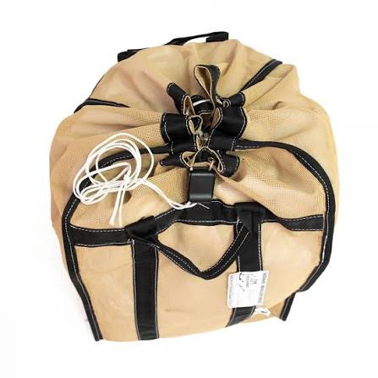
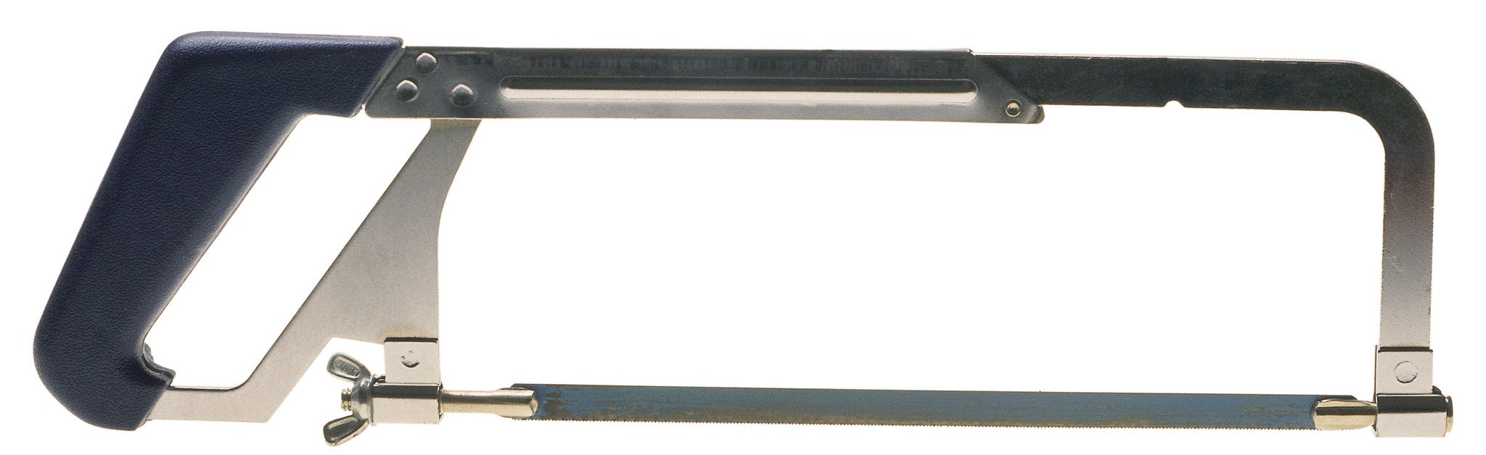

Slide 65
You clicked somewhere wrong..
Click on highlighted items:
BACK

Slide 66
You clicked somewhere wrong..
Click on highlighted items:
BACK

Slide 67
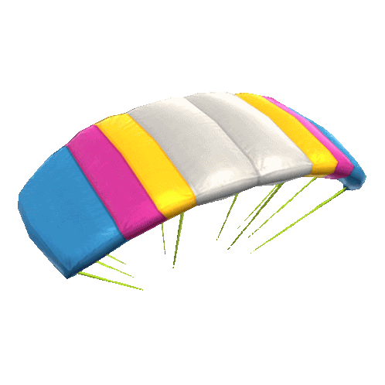

ENTRANCE

Slide 68
ENTRANCE

Slide 69
YOU DIED
ENTRANCE
The parachute was too slow.
RETRY

Slide 70
You clicked somewhere wrong..
Click on highlighted items:
BACK

Slide 71
You clicked somewhere wrong..
Click on highlighted items:
BACK

Slide 72
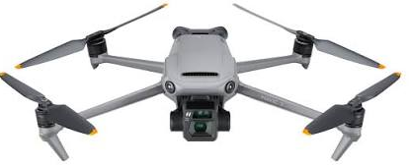
ENTRANCE

Slide 73
ENTRANCE

Slide 74
YOU ESCAPED
ENTRANCE
You escaped on the drone.
RETRY

Slide 75
You clicked somewhere wrong..
Click on highlighted items:
BACK

Slide 76
You clicked somewhere wrong..
Click on highlighted items:
BACK

Slide 78
You clicked somewhere wrong..
Click on highlighted items:
BACK

Slide 79
You clicked somewhere wrong..
Click on highlighted items:
BACK

Slide 81
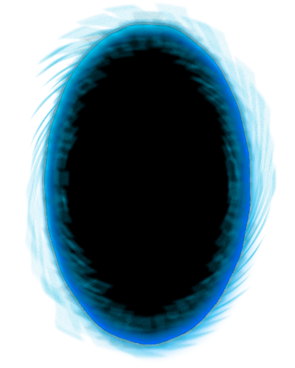

Slide 82
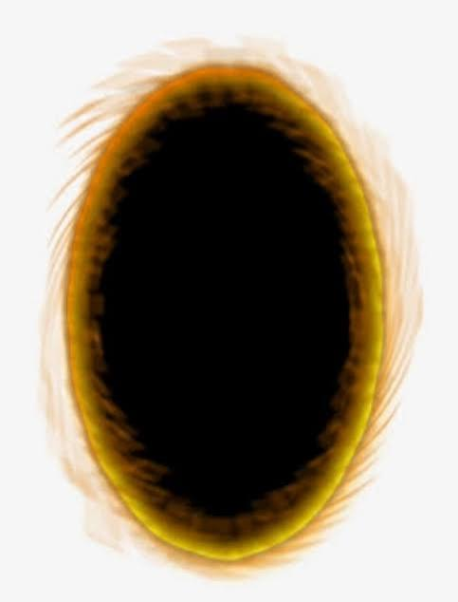

Slide 83
You clicked somewhere wrong..
Click on highlighted items:
BACK

Slide 84
You clicked somewhere wrong..
Click on highlighted items:
BACK

Slide 88
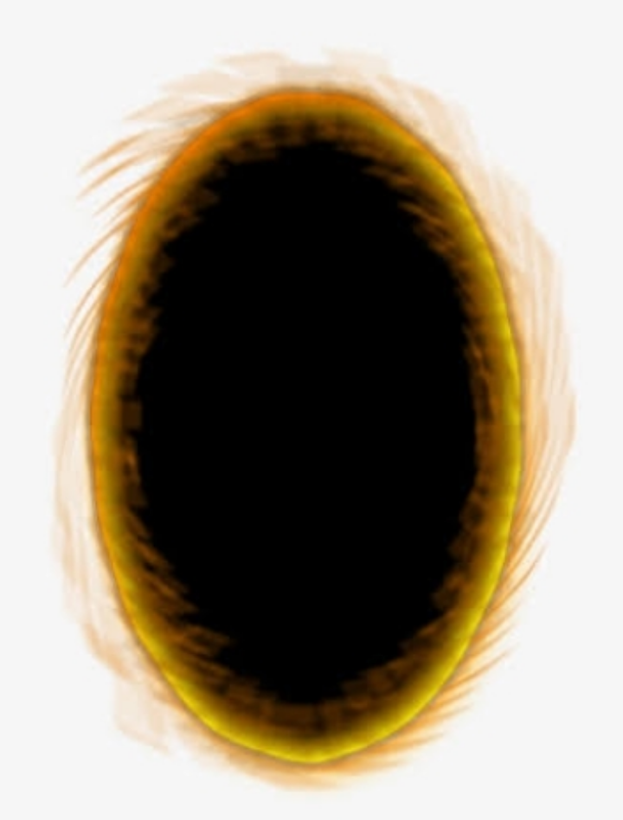


Slide 90
YOU DIED
You fell to your death after the portal hit a wall.
RETRY

Slide 91
You clicked somewhere wrong..
Click on highlighted items:
BACK

Slide 92
You clicked somewhere wrong..
Click on highlighted items:
BACK

Slide 93


Slide 94


Slide 96


Slide 99
YOU DIED
The fire spread and the room filled with CO₂.
RETRY

Slide 100
You clicked somewhere wrong..
Click on highlighted items:
BACK

Slide 101
You clicked somewhere wrong..
Click on highlighted items:
BACK

Slide 102





Slide 103
You clicked somewhere wrong..
Click on highlighted items:
BACK

Slide 104
You clicked somewhere wrong..
Click on highlighted items:
BACK

Slide 105
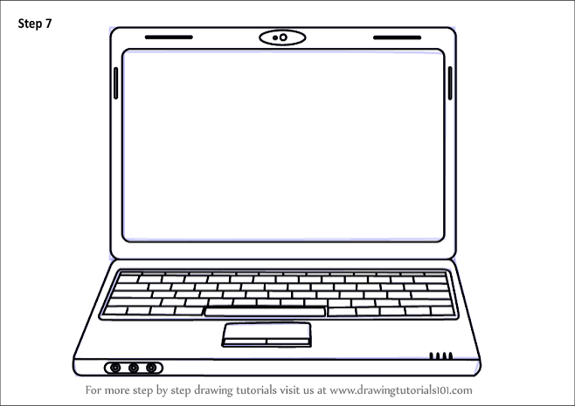
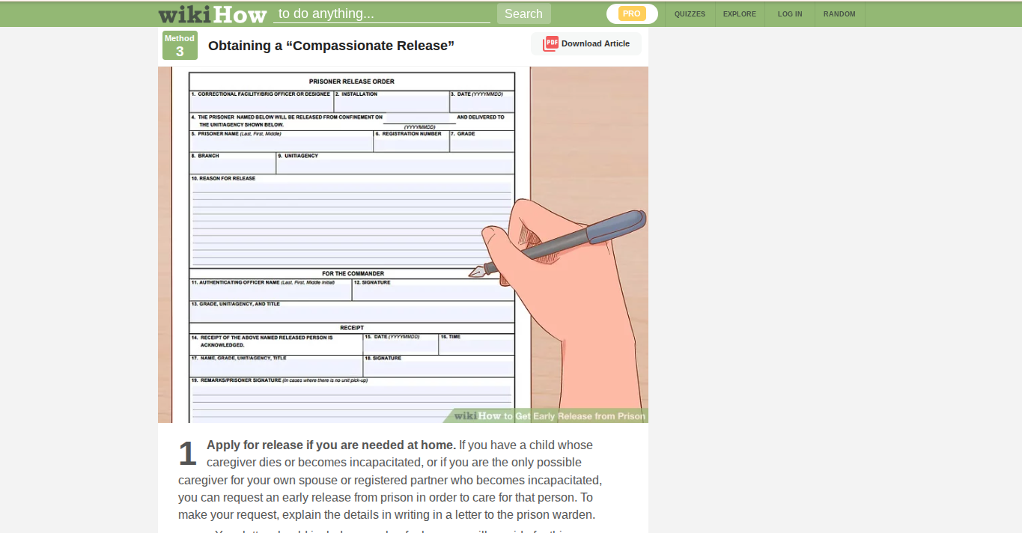

Slide 106
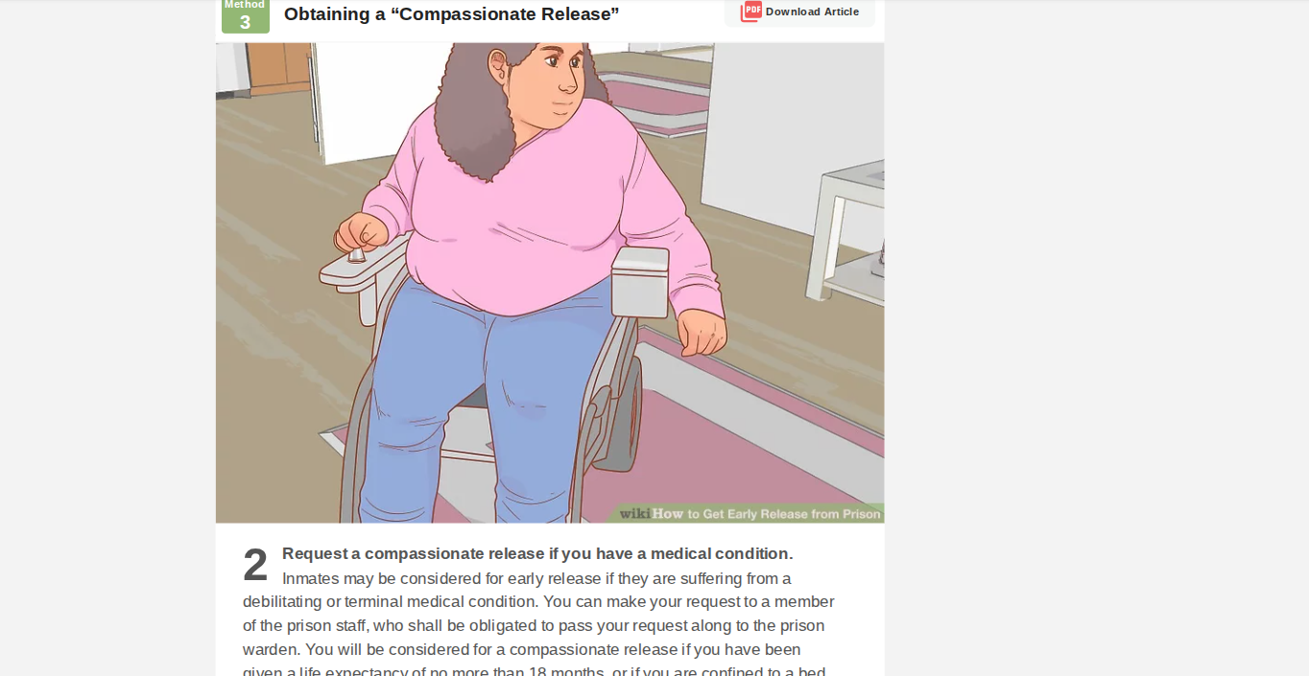

Slide 107


Slide 110
YOU DIED
Died to lightbulb eating
RETRY

Slide 111
You clicked somewhere wrong..
Click on highlighted items:
BACK

Slide 112
You clicked somewhere wrong..
Click on highlighted items:
BACK

Slide 116




Slide 117

ENTRANCE

Slide 118
YOU ESCAPED
ENTRANCE
You were released for being sick.
RETRY

Slide 119
You clicked somewhere wrong..
Click on highlighted items:
BACK

Slide 120
You clicked somewhere wrong..
Click on highlighted items:
BACK

Slide 121
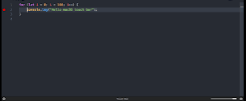

Slide 122
jailWifi = hacked

Slide 123
jailWifi = hacked
celldoors = open

Slide 124



Slide 126
You clicked somewhere wrong..
Click on highlighted items:
BACK

Slide 127
You clicked somewhere wrong..
Click on highlighted items:
BACK

Slide 128


Slide 129
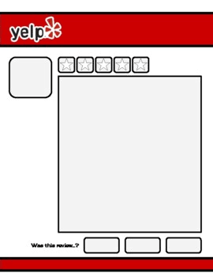
THE JAIL
he jail has terrible food, terrible treatment of prisoners, and terrikible rooms. shut it down!!
SUBMIT

Slide 130


Slide 131


Slide 132


Slide 133



Slide 134
YOU DIED
You were abandoned after the jail was shut down..
RETRY

Slide 135
You clicked somewhere wrong..
Click on highlighted items:
BACK

Slide 136
You clicked somewhere wrong..
Click on highlighted items:
BACK

Slide 137


2026

Slide 138

2028

Slide 139
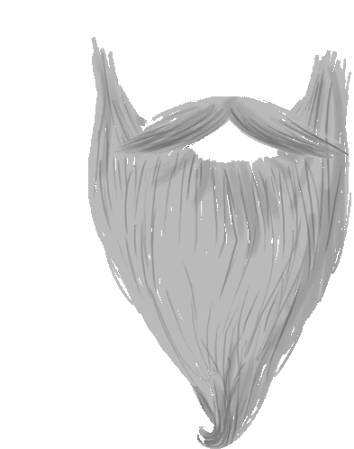
2032

Slide 140
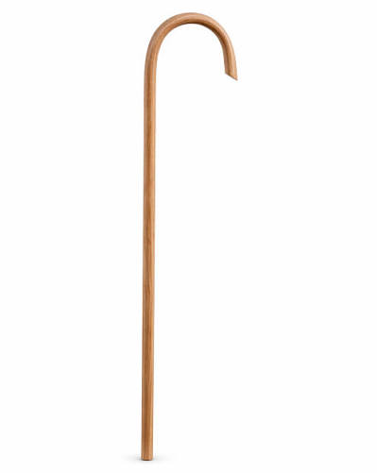
2045

Slide 141
2060

Slide 142
Your times up.
2060

Slide 143


Slide 145

YOU DIED
You died of old age.
RETRY

Slide 146
You clicked somewhere wrong..
Click on highlighted items:
BACK

Slide 147
You clicked somewhere wrong..
Click on highlighted items:
BACK

Slide 148


Slide 149
You clicked somewhere wrong..
Click on highlighted items:
BACK

Slide 150
You clicked somewhere wrong..
Click on highlighted items:
BACK

Slide 152


Slide 153
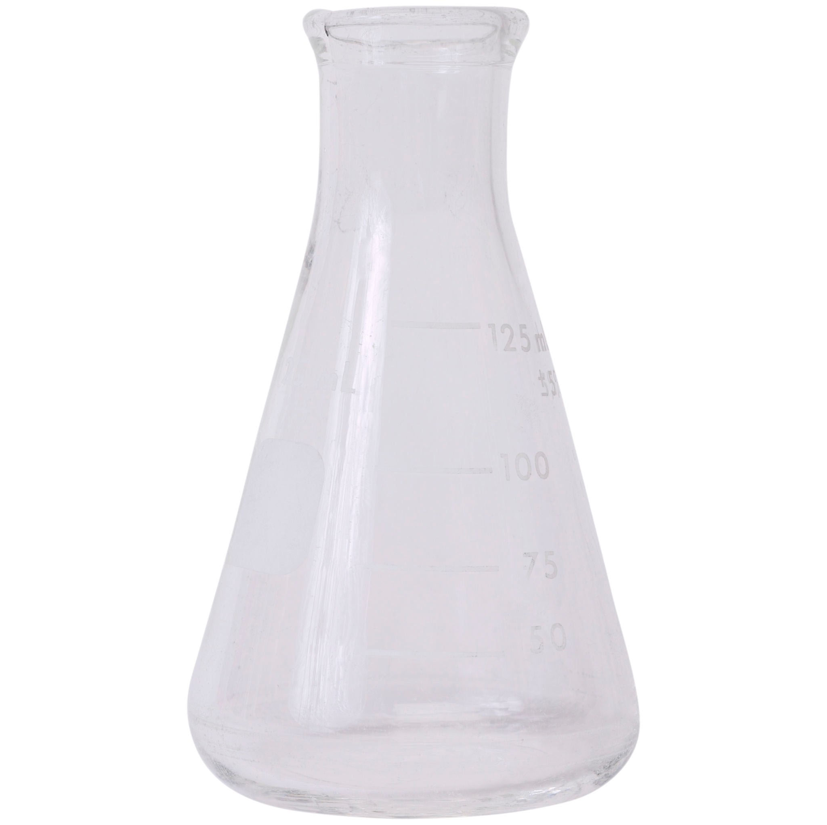

Slide 155
You clicked somewhere wrong..
Click on highlighted items:
BACK

Slide 156
You clicked somewhere wrong..
Click on highlighted items:
BACK

Slide 160


Slide 161
YOU DIED
Poisoned
RETRY

Slide 162
You clicked somewhere wrong..
Click on highlighted items:
BACK

Slide 163
You clicked somewhere wrong..
Click on highlighted items:
BACK

Slide 165


Slide 170
You clicked somewhere wrong..
Click on highlighted items:
BACK

Slide 171
You clicked somewhere wrong..
Click on highlighted items:
BACK

Slide 172
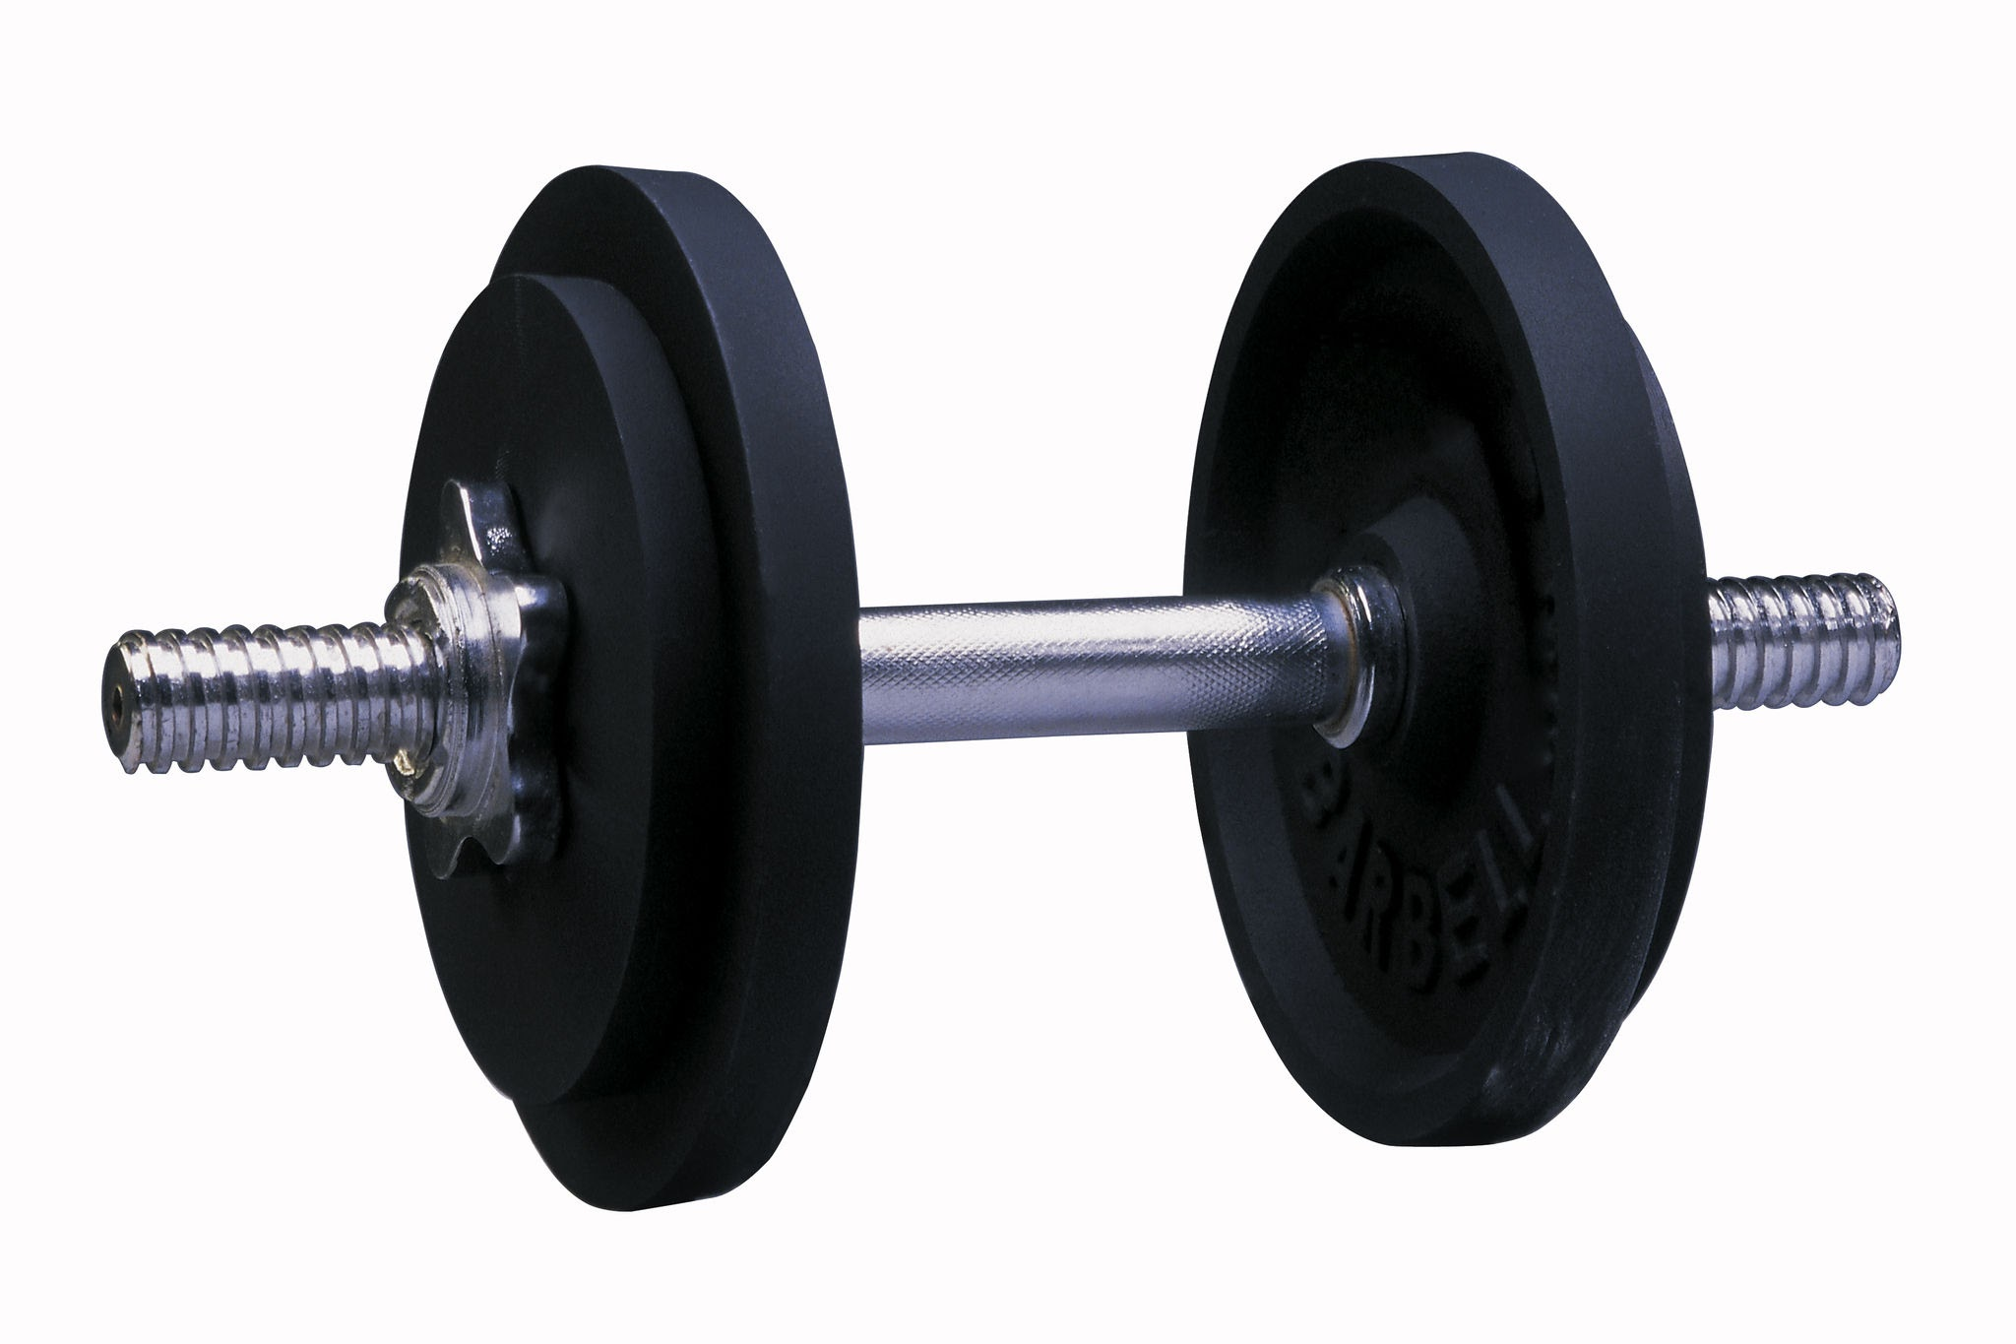

Slide 177


Slide 180
You clicked somewhere wrong..
Click on highlighted items:
BACK

Slide 181
You clicked somewhere wrong..
Click on highlighted items:
BACK

Slide 182
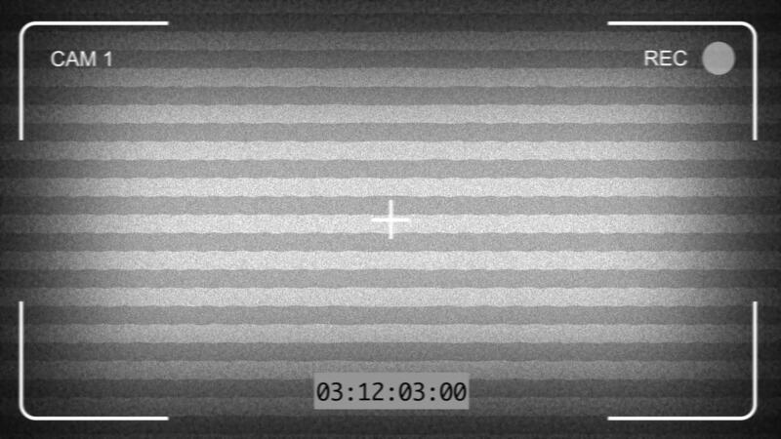


LEFT
CAM 01 - CELLBLOCK

Slide 183
CAM 02 - ENTRANCE

Slide 184
CAM 02 - ENTRANCE

Slide 185
CAM 02 - ENTRANCE

Slide 186
YOU DIED
If only you were stronger..
RETRY

Slide 187
You clicked somewhere wrong..
Click on highlighted items:
BACK

Slide 188
You clicked somewhere wrong..
Click on highlighted items:
BACK

Slide 189

LEFT
CAM 01 - CELLBLOCK

Slide 190
CAM 02 - ENTRANCE

Slide 191
CAM 02 - ENTRANCE

Slide 192
CAM 02 - ENTRANCE

Slide 193
ENTRANCE

Slide 194
ENTRANCE

Slide 195
YOU ESCAPED
ENTRANCE
You escaped by fighting.
RETRY

